Slide 1



OVS DPDK issues in Openstack and Kubernetes and Solutions
Yi Yang @ Inspur Cloud

Slide 2
Background
1
Inspur uses Openstack for both private cloud and public cloud
Openstack Neutron is current networking solution
We need high speed VM networking in high performance computing scenario
OVS DPDK is one choice for such scenario very naturally
OVS DPDK isn’t perfect in Openstack
Neutron used tap and veth for floating IP, L3 routing and SNAT
Neutron is using iptables (conntrack) to do floating IP and SNAT
Security group also is using iptables by default unless you configure it to use openvswitch

Slide 3
Openstack details for floating IP
2
yangyi@cmp001:~$ sudo ip netns
qrouter-8ac7b1e1-6f11-4512-ae51-5507b03a5c69 (id: 5)
fip-1cff74b1-c21d-4020-b198-bf53bfd4d1a2 (id: 6)
qrouter-6bf9d3c6-2170-44f4-89fc-a2ca93b32c39 (id: 0)
cni-cedab60e-ac62-9d51-6e88-34779cb10cbb (id: 2)
cni-048dc0a3-761a-21c4-0cfc-61bbbb5dcfb0 (id: 1)
fip-0ea1e7a1-e071-482f-97db-fd145dbd8690 (id: 3)
yangyi@cmp001:~$

Slide 4
Openstack details for floating IP
3
yangyi@cmp001:~$ sudo ip netns exec fip-1cff74b1-c21d-4020-b198-bf53bfd4d1a2 ifconfig
fg-be43aaf8-2a Link encap:Ethernet HWaddr fa:16:3e:81:07:79
inet addr:172.16.0.203 Bcast:172.16.255.255 Mask:255.255.0.0
inet6 addr: fe80::f816:3eff:fe81:779/64 Scope:Link
UP BROADCAST RUNNING MULTICAST MTU:1500 Metric:1
RX packets:787 errors:0 dropped:0 overruns:0 frame:0
TX packets:195 errors:0 dropped:0 overruns:0 carrier:0
collisions:0 txqueuelen:1000
RX bytes:49334 (49.3 KB) TX bytes:22447 (22.4 KB)
fpr-8ac7b1e1-6 Link encap:Ethernet HWaddr 4a:c2:86:f7:34:b3
inet addr:169.254.106.115 Bcast:0.0.0.0 Mask:255.255.255.254
inet6 addr: fe80::48c2:86ff:fef7:34b3/64 Scope:Link
UP BROADCAST RUNNING MULTICAST MTU:1500 Metric:1
RX packets:42 errors:0 dropped:0 overruns:0 frame:0
TX packets:43 errors:0 dropped:0 overruns:0 carrier:0
collisions:0 txqueuelen:1000
RX bytes:6632 (6.6 KB) TX bytes:6255 (6.2 KB)

Slide 5
Openstack details for floating IP
4
yangyi@cmp001:~$ sudo ovs-vsctl show | less
407b6a8a-b261-4e10-8299-395757e16b22
Manager "ptcp:6640:127.0.0.1"
is_connected: true
Bridge br-int
Controller "tcp:127.0.0.1:6633"
is_connected: true
fail_mode: secure
Port "qr-4cf5de11-6f"
tag: 3
Interface "qr-4cf5de11-6f"
type: internal
……
Port int-br-floating
Interface int-br-floating
type: patch
options: {peer=phy-br-floating}
Port "fg-be43aaf8-2a"
tag: 6
Interface "fg-be43aaf8-2a"
type: internal
Port "tapcde739ab-ce"
tag: 9

Slide 6
Openstack details for floating IP
5
yangyi@cmp001:~$ sudo ip netns exec fip-1cff74b1-c21d-4020-b198-bf53bfd4d1a2 ethtool -i fg-be43aaf8-2a
driver: openvswitch
version:
firmware-version:
expansion-rom-version:
bus-info:
supports-statistics: no
supports-test: no
supports-eeprom-access: no
supports-register-dump: no
supports-priv-flags: no
yangyi@cmp001:~$ sudo ip netns exec fip-1cff74b1-c21d-4020-b198-bf53bfd4d1a2 ethtool -i fpr-8ac7b1e1-6
driver: veth
version: 1.0
firmware-version:
expansion-rom-version:
bus-info:
supports-statistics: yes
supports-test: no
supports-eeprom-access: no
supports-register-dump: no
supports-priv-flags: no
yangyi@cmp001:~$

Slide 7
Openstack details for floating IP
6
yangyi@cmp001:~$ sudo ip netns exec qrouter-8ac7b1e1-6f11-4512-ae51-5507b03a5c69 ifconfig
……
qr-d15e0a82-f1 Link encap:Ethernet HWaddr fa:16:3e:00:ae:75
inet addr:10.15.1.1 Bcast:10.15.1.255 Mask:255.255.255.0
inet6 addr: fe80::f816:3eff:fe00:ae75/64 Scope:Link
UP BROADCAST RUNNING MULTICAST MTU:1450 Metric:1
RX packets:783 errors:0 dropped:0 overruns:0 frame:0
TX packets:600 errors:0 dropped:0 overruns:0 carrier:0
collisions:0 txqueuelen:1000
RX bytes:78181 (78.1 KB) TX bytes:60010 (60.0 KB)
rfp-8ac7b1e1-6 Link encap:Ethernet HWaddr fa:68:07:ec:9c:b8
inet addr:169.254.106.114 Bcast:0.0.0.0 Mask:255.255.255.254
inet6 addr: fe80::f868:7ff:feec:9cb8/64 Scope:Link
UP BROADCAST RUNNING MULTICAST MTU:1500 Metric:1
RX packets:43 errors:0 dropped:0 overruns:0 frame:0
TX packets:42 errors:0 dropped:0 overruns:0 carrier:0
collisions:0 txqueuelen:1000
RX bytes:6255 (6.2 KB) TX bytes:6632 (6.6 KB)
yangyi@cmp001:~$
fpr-8ac7b1e1-6 in fip namespace is its veth pair peer

Slide 8
Openstack details for floating IP
7
yangyi@cmp001:~$ sudo ovs-vsctl show | less
Bridge br-int
Controller "tcp:127.0.0.1:6633"
is_connected: true
fail_mode: secure
…….
Port int-br-floating
Interface int-br-floating
type: patch
options: {peer=phy-br-floating}
Port "fg-be43aaf8-2a"
tag: 6
Interface "fg-be43aaf8-2a"
type: internal
……
Port br-int
Interface br-int
type: internal
Port "qr-d15e0a82-f1"
tag: 9
Interface "qr-d15e0a82-f1"
type: internal

Slide 9
Openstack details for floating IP
8
yangyi@cmp001:~$ sudo ip netns exec qrouter-8ac7b1e1-6f11-4512-ae51-5507b03a5c69 ethtool -i qr-d15e0a82-f1
driver: openvswitch
version:
firmware-version:
expansion-rom-version:
bus-info:
supports-statistics: no
supports-test: no
supports-eeprom-access: no
supports-register-dump: no
supports-priv-flags: no
yangyi@cmp001:~$ sudo ip netns exec qrouter-8ac7b1e1-6f11-4512-ae51-5507b03a5c69 ethtool -i rfp-8ac7b1e1-6
driver: veth
version: 1.0
firmware-version:
expansion-rom-version:
bus-info:
supports-statistics: yes
supports-test: no
supports-eeprom-access: no
supports-register-dump: no
supports-priv-flags: no
yangyi@cmp001:~$

Slide 10
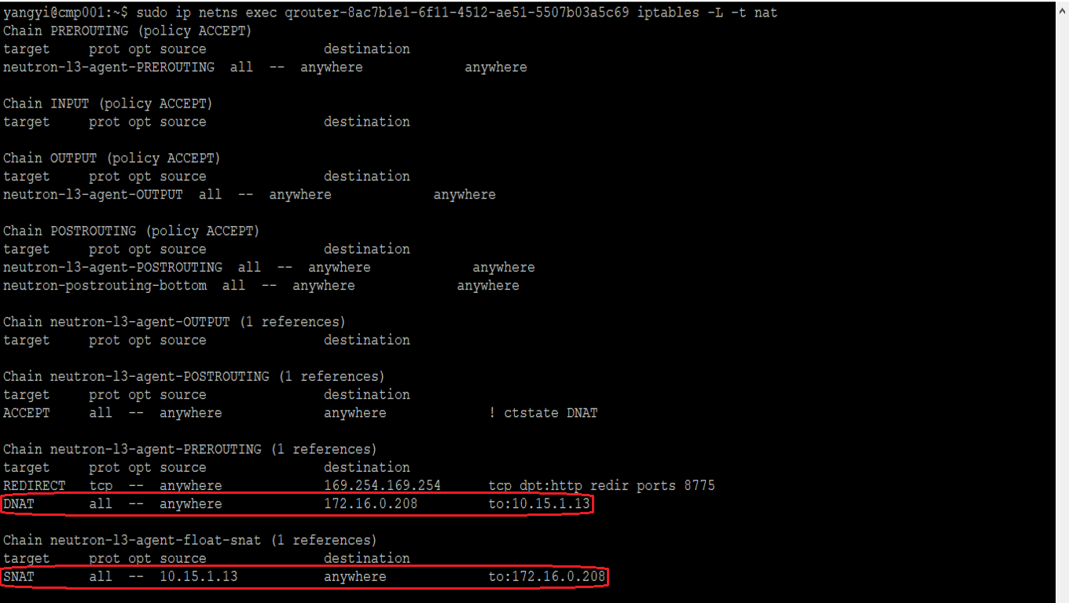
Openstack details for floating IP
9

Slide 11
Openstack details for floating IP
10
yangyi@cmp001:~$ sudo ip netns exec qrouter-8ac7b1e1-6f11-4512-ae51-5507b03a5c69 ip route
10.15.1.0/24 dev qr-d15e0a82-f1 proto kernel scope link src 10.15.1.1
10.16.2.0/24 dev qr-ad2e6cb4-ac proto kernel scope link src 10.16.2.1
169.254.106.114/31 dev rfp-8ac7b1e1-6 proto kernel scope link src 169.254.106.114
yangyi@cmp001:~$ sudo ip netns exec fip-1cff74b1-c21d-4020-b198-bf53bfd4d1a2 ip route
169.254.106.114/31 dev fpr-8ac7b1e1-6 proto kernel scope link src 169.254.106.115
172.16.0.0/16 dev fg-be43aaf8-2a proto kernel scope link src 172.16.0.203
172.16.0.208 via 169.254.106.114 dev fpr-8ac7b1e1-6
yangyi@cmp001:~$

Slide 12
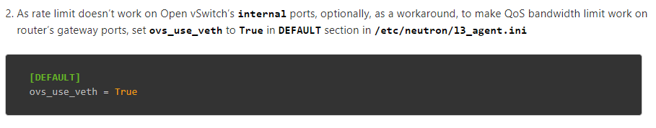
Openstack details for floating IP
11
Have to use veth for floating IP QoS because rate limit can’t work on tap port
https://docs.openstack.org/neutron/latest/admin/config-qos.html

Slide 13
Openstack details for routing
12
yangyi@cmp001:~$ sudo ip netns exec qrouter-8ac7b1e1-6f11-4512-ae51-5507b03a5c69 ifconfig
qr-ad2e6cb4-ac Link encap:Ethernet HWaddr fa:16:3e:69:4a:eb
inet addr:10.16.2.1 Bcast:10.16.2.255 Mask:255.255.255.0
inet6 addr: fe80::f816:3eff:fe69:4aeb/64 Scope:Link
UP BROADCAST RUNNING MULTICAST MTU:1450 Metric:1
RX packets:5 errors:0 dropped:0 overruns:0 frame:0
TX packets:13 errors:0 dropped:0 overruns:0 carrier:0
collisions:0 txqueuelen:1000
RX bytes:320 (320.0 B) TX bytes:998 (998.0 B)
qr-d15e0a82-f1 Link encap:Ethernet HWaddr fa:16:3e:00:ae:75
inet addr:10.15.1.1 Bcast:10.15.1.255 Mask:255.255.255.0
inet6 addr: fe80::f816:3eff:fe00:ae75/64 Scope:Link
UP BROADCAST RUNNING MULTICAST MTU:1450 Metric:1
RX packets:7780 errors:0 dropped:0 overruns:0 frame:0
TX packets:6509 errors:0 dropped:0 overruns:0 carrier:0
collisions:0 txqueuelen:1000
RX bytes:804891 (804.8 KB) TX bytes:525910 (525.9 KB)
yangyi@cmp001:~$

Slide 14
Openstack details for routing
13
yangyi@cmp001:~$ sudo ovs-vsctl show | egrep -A 1 "qr-ad2e6cb4-ac|qr-d15e0a82-f1"
Port "qr-ad2e6cb4-ac"
tag: 10
Interface "qr-ad2e6cb4-ac"
type: internal
--
Port "qr-d15e0a82-f1"
tag: 9
Interface "qr-d15e0a82-f1"
type: internal
yangyi@cmp001:~$ sudo ip netns exec qrouter-8ac7b1e1-6f11-4512-ae51-5507b03a5c69 route
Kernel IP routing table
Destination Gateway Genmask Flags Metric Ref Use Iface
10.15.1.0 * 255.255.255.0 U 0 0 0 qr-d15e0a82-f1
10.16.2.0 * 255.255.255.0 U 0 0 0 qr-ad2e6cb4-ac
169.254.106.114 * 255.255.255.254 U 0 0 0 rfp-8ac7b1e1-6
yangyi@cmp001:~$

Slide 15
Openstack details for snat
14
yangyi@gtw01:~$ sudo ip netns exec snat-8ac7b1e1-6f11-4512-ae51-5507b03a5c69 ifconfig
qg-a9e18c37-a3 Link encap:Ethernet HWaddr fa:16:3e:d8:17:be
inet addr:172.16.0.200 Bcast:172.16.255.255 Mask:255.255.0.0
inet6 addr: fe80::f816:3eff:fed8:17be/64 Scope:Link
UP BROADCAST RUNNING MULTICAST MTU:1500 Metric:1
RX packets:15389 errors:0 dropped:0 overruns:0 frame:0
TX packets:38892 errors:0 dropped:0 overruns:0 carrier:0
collisions:0 txqueuelen:1000
RX bytes:781466 (781.4 KB) TX bytes:2598026 (2.5 MB)
sg-838ed506-e4 Link encap:Ethernet HWaddr fa:16:3e:aa:9d:42
inet addr:10.15.1.11 Bcast:10.15.1.255 Mask:255.255.255.0
inet6 addr: fe80::f816:3eff:feaa:9d42/64 Scope:Link
UP BROADCAST RUNNING MULTICAST MTU:1450 Metric:1
RX packets:30116 errors:0 dropped:0 overruns:0 frame:0
TX packets:45 errors:0 dropped:0 overruns:0 carrier:0
collisions:0 txqueuelen:1000
RX bytes:1808350 (1.8 MB) TX bytes:2358 (2.3 KB)
sg-eb6d0a4e-f9 Link encap:Ethernet HWaddr fa:16:3e:19:12:83
inet addr:10.16.2.10 Bcast:10.16.2.255 Mask:255.255.255.0
inet6 addr: fe80::f816:3eff:fe19:1283/64 Scope:Link
UP BROADCAST RUNNING MULTICAST MTU:1450 Metric:1
RX packets:15 errors:0 dropped:1 overruns:0 frame:0
TX packets:41 errors:0 dropped:0 overruns:0 carrier:0
collisions:0 txqueuelen:1000
RX bytes:464 (464.0 B) TX bytes:1998 (1.9 KB)

Slide 16
Openstack details for snat
15
yangyi@gtw01:~$ sudo ip netns exec qrouter-8ac7b1e1-6f11-4512-ae51-5507b03a5c69 ifconfig
qr-ad2e6cb4-ac Link encap:Ethernet HWaddr fa:16:3e:69:4a:eb
inet addr:10.16.2.1 Bcast:10.16.2.255 Mask:255.255.255.0
inet6 addr: fe80::f816:3eff:fe69:4aeb/64 Scope:Link
UP BROADCAST RUNNING MULTICAST MTU:1450 Metric:1
RX packets:44 errors:0 dropped:1 overruns:0 frame:0
TX packets:25 errors:0 dropped:0 overruns:0 carrier:0
collisions:0 txqueuelen:1000
RX bytes:1664 (1.6 KB) TX bytes:1502 (1.5 KB)
qr-d15e0a82-f1 Link encap:Ethernet HWaddr fa:16:3e:00:ae:75
inet addr:10.15.1.1 Bcast:10.15.1.255 Mask:255.255.255.0
inet6 addr: fe80::f816:3eff:fe00:ae75/64 Scope:Link
UP BROADCAST RUNNING MULTICAST MTU:1450 Metric:1
RX packets:46 errors:0 dropped:0 overruns:0 frame:0
TX packets:25 errors:0 dropped:0 overruns:0 carrier:0
collisions:0 txqueuelen:1000
RX bytes:2336 (2.3 KB) TX bytes:1502 (1.5 KB)

Slide 17
Openstack details for snat
16
yangyi@gtw01:~$ sudo ovs-vsctl show | egrep -A 3 "Port \"qg-a9e18c37-a3|Port \"sg-838ed506-e4|Port \"sg-eb6d0a4e-f9|Port \"qr-ad2e6cb4-ac|Port \"qr-d15e0a82-f1"
Port "qr-d15e0a82-f1"
tag: 6
Interface "qr-d15e0a82-f1"
type: internal
Port "sg-eb6d0a4e-f9"
tag: 5
Interface "sg-eb6d0a4e-f9"
type: internal
--
Port "sg-838ed506-e4"
tag: 6
Interface "sg-838ed506-e4"
type: internal
--
Port "qg-a9e18c37-a3"
tag: 7
Interface "qg-a9e18c37-a3"
type: internal
--
Port "qr-ad2e6cb4-ac"
tag: 5
Interface "qr-ad2e6cb4-ac"
type: internal

Slide 18
Openstack details for snat
17
yangyi@gtw01:~$ sudo ip netns exec snat-8ac7b1e1-6f11-4512-ae51-5507b03a5c69 iptables -L -t nat
……
Chain neutron-l3-agent-snat (1 references)
target prot opt source destination
neutron-l3-agent-float-snat all -- anywhere anywhere
SNAT all -- anywhere anywhere to:172.16.0.200
SNAT all -- anywhere anywhere mark match ! 0x2/0xffff ctstate DNAT to:172.16.0.200
Chain neutron-postrouting-bottom (1 references)
target prot opt source destination
neutron-l3-agent-snat all -- anywhere anywhere /* Perform source NAT on outgoing traffic. */
yangyi@gtw01:~$ sudo ip netns exec snat-8ac7b1e1-6f11-4512-ae51-5507b03a5c69 ip route
default via 172.16.255.254 dev qg-a9e18c37-a3
10.15.1.0/24 dev sg-838ed506-e4 proto kernel scope link src 10.15.1.11
10.16.2.0/24 dev sg-eb6d0a4e-f9 proto kernel scope link src 10.16.2.10
172.16.0.0/16 dev qg-a9e18c37-a3 proto kernel scope link src 172.16.0.200
yangyi@gtw01:~$

Slide 19
Openstack details for snat
18
yangyi@gtw01:~$ sudo ip netns
qdhcp-7c3c4203-35c7-45b2-84ae-ca52cb307250 (id: 20)
qrouter-46fc6730-a7f9-45f7-b98b-f682c436e85c (id: 13)
snat-ec4ed894-3d6d-484a-a708-ceaac36973f1 (id: 12)
fip-1cff74b1-c21d-4020-b198-bf53bfd4d1a2 (id: 11)
qrouter-6bf9d3c6-2170-44f4-89fc-a2ca93b32c39 (id: 7)
qdhcp-88138329-f59d-48db-9984-346b990b3762 (id: 4)
qdhcp-e0898091-7722-44df-9b70-db2a239d0958 (id: 19)
qdhcp-ac2428db-7b81-4161-b30e-37d11831a44a (id: 18)
qdhcp-7fb20f34-42b7-47df-91f5-24ba093de6dc (id: 15)
snat-e989283a-c4e4-485a-869a-6140b563d495 (id: 17)
snat-8ac7b1e1-6f11-4512-ae51-5507b03a5c69 (id: 9)
qrouter-8ac7b1e1-6f11-4512-ae51-5507b03a5c69 (id: 8)
snat-6bf2c89e-f50c-4f5b-8c3e-82534d54d3fe (id: 6)
qrouter-6bf2c89e-f50c-4f5b-8c3e-82534d54d3fe (id: 5)
qrouter-ec4ed894-3d6d-484a-a708-ceaac36973f1 (id: 2)
qdhcp-0bf35e4c-0cde-4edb-9177-2c208718e765 (id: 1)
qrouter-e989283a-c4e4-485a-869a-6140b563d495 (id: 14)
qdhcp-326de886-1373-4fb5-9dd5-5681b59a6e19 (id: 16)
qdhcp-209c8a4f-ebad-4dd9-a204-be1024c1c6f1 (id: 10)
fip-0ea1e7a1-e071-482f-97db-fd145dbd8690 (id: 3)
yangyi@gtw01:~$

Slide 20
Openstack details for snat
19
yangyi@gtw01:~$ sudo ovs-vsctl show | grep "Port "
Port "vxlan-ac1f1757"
Port "vxlan-ac1f1541"
Port "vxlan-ac1f1753"
Port "vxlan-ac1f1546"
Port "vxlan-ac1f185f"
Port "vxlan-ac1f164b"
Port "vxlan-ac1f1542"
Port "vxlan-ac1f1754"
Port "vxlan-ac1f1547"
Port "vxlan-ac1f1545"
Port "vxlan-ac1f1549"
Port "vxlan-ac1f185c"
Port "vxlan-ac1f1593"
Port "vxlan-ac1f1544"
Port "vxlan-ac1f1594"
Port "vxlan-ac1f1543"
Port "vxlan-ac1f1548"
Port "vxlan-ac1f1540"
Port "vxlan-ac1f185b"
Port "qr-cf53517a-bf"
Port "qg-06901729-87"
Port "qr-d15e0a82-f1"
Port "qr-ad2e6cb4-ac"
Port "qr-c7ff9e5c-11"
Port "sg-4c143146-cf"
Port "fg-9d1ac847-bd"
Port "tapa71ad442-85"
Port "qr-1ba4939f-49"
Port "sg-f1a0a239-e3"
Port "sg-0eb89144-7a"
Port "qr-d6ab4031-93"
Port "tap938594cf-dd"
Port "fg-8fd7d677-42"
Port "sg-eb6d0a4e-f9"
Port "sg-cda2d1e6-97"
Port "sg-e4052487-f7"
Port "sg-85e91b82-64"
Port "qr-593e0f3d-f0"
Port "qr-4cf5de11-6f"
Port "tap54aae42e-05"
Port "sg-838ed506-e4"
Port "tapa75ae517-33"
Port "sg-c4b9c1d2-e5"
Port "tap3f8f54bb-8a"
Port "tap0d0dc85a-21"
Port "qg-6692efa8-80"
Port "tapc35f63a8-4b"
Port "qr-0dac84b5-c9"
Port "qg-a9e18c37-a3"
Port "tap3bd8d900-45"
Port "sg-6bcd6638-1e"
Port "qg-3c69b776-66"
Port "qr-90675ff6-c3"
Port "qr-969255e2-e0"
Port "qr-b69f243f-5e"

Slide 21
Summary for Openstack floating IP, routing, SNAT
20
Depends on iptables (conntrack)
Uses tap and veth
Uses Linux kernel ip routing
Uses OVS
Mixed data plane (iptables, in-kernel routing, OVS kernel data path)
SNAT gateway has too many OVS ports, performance will become worse and worse with number of ports increasing
one port for floating IP per external router
one port for SNAT per subnets
VXLAN port per compute node
one port for default gateway per subnet

Slide 22
Background for k8s
21
Unify networking for for VMs, baremetals and containers (including kata container)
VMs, baremetals and containers must be able intercommunicate in L2 and L3
Openstack Neutron is only one solution for it to us
Integrated kuryr-kubernetes for k8s
Both Normal container or katacontainer can run on the same baremetal at the same time
OVS/OVS DPDK is dataplane
veth pair is used for container

Slide 23
Details for k8s pods running on OVS bridge (normal)
22
yangyi@cmp001:~$ kubectl get pods -o wide
NAME READY STATUS RESTARTS AGE IP NODE NOMINATED NODE READINESS GATES
kuryr-1-65f94987d9-r8sl6 1/1 Running 0 9m2s 10.1.0.20 cmp004 <none> <none>
kuryr-3-c944dcb55-rnpf7 1/1 Running 0 8m14s 10.1.0.16 cmp004 <none> <none>
yangyi@cmp001:~$

Slide 24
Details for k8s pods running on OVS bridge (normal)
23
yangyi@cmp004:~$ sudo ip netns | grep cni
cni-60fa38b7-8425-7755-e822-13e9ae956379 (id: 7)
cni-f80dcafe-6187-6de7-9e29-f7766b8c060a (id: 2)
yangyi@cmp004:~$ sudo ip netns exec cni-f80dcafe-6187-6de7-9e29-f7766b8c060a ip addr show eth0
3: eth0@if318: <BROADCAST,MULTICAST,UP,LOWER_UP> mtu 1450 qdisc noqueue state UP group default qlen 1000
link/ether fa:16:3e:51:7e:95 brd ff:ff:ff:ff:ff:ff link-netnsid 0
inet 10.1.0.20/16 scope global eth0
valid_lft forever preferred_lft forever
inet6 fe80::f816:3eff:fe51:7e95/64 scope link
valid_lft forever preferred_lft forever
yangyi@cmp004:~$ sudo ip link list | grep -A 1 ^318
318: tap0d5473de-50@if3: <BROADCAST,MULTICAST,UP,LOWER_UP> mtu 1450 qdisc noqueue master ovs-system state UP mode DEFAULT group default qlen 10000
link/ether 6e:73:3c:cd:69:7f brd ff:ff:ff:ff:ff:ff link-netnsid 2
yangyi@cmp004:~$

Slide 25
24
Details for k8s pods running on OVS bridge (normal)
yangyi@cmp004:~$ sudo ip netns exec cni-f80dcafe-6187-6de7-9e29-f7766b8c060a ethtool -i eth0
driver: veth
version: 1.0
firmware-version:
expansion-rom-version:
bus-info:
……
yangyi@cmp004:~$ sudo ethtool -i tap0d5473de-50
driver: veth
version: 1.0
firmware-version:
expansion-rom-version:
bus-info:
……
yangyi@cmp004:~$ sudo ovs-vsctl show | grep -A 2 "Port \"tap0d5473de-50"
Port "tap0d5473de-50"
tag: 101
Interface "tap0d5473de-50"
yangyi@cmp004:~$

Slide 26
Details for k8s pods running on OVS bridge (normal)
25
yangyi@cmp001:~$ kubectl get pods -o wide
NAME READY STATUS RESTARTS AGE IP NODE NOMINATED NODE READINESS GATES
kuryr-1-65f94987d9-r8sl6 1/1 Running 0 58m 10.1.0.20 cmp004 <none> <none>
kuryr-3-c944dcb55-rnpf7 1/1 Running 0 57m 10.1.0.16 cmp004 <none> <none>
yangyi@cmp001:~$ kubectl get deployments
NAME READY UP-TO-DATE AVAILABLE AGE
kuryr-1 1/1 1 1 58m
kuryr-3 1/1 1 1 58m
yangyi@cmp001:~$ kubectl attach kuryr-1-65f94987d9-r8sl6 -c kuryr-1 -it
If you don't see a command prompt, try pressing enter.
root@kuryr-1-65f94987d9-r8sl6:/# ethtool -i eth0 | grep veth
driver: veth
root@kuryr-1-65f94987d9-r8sl6:/# ip addr show eth0 | grep "inet "
inet 10.1.0.20/16 scope global eth0
root@kuryr-1-65f94987d9-r8sl6:/# ping -c 3 10.1.0.16
PING 10.1.0.16 (10.1.0.16): 56 data bytes
64 bytes from 10.1.0.16: icmp_seq=0 ttl=64 time=0.376 ms
64 bytes from 10.1.0.16: icmp_seq=1 ttl=64 time=0.214 ms
64 bytes from 10.1.0.16: icmp_seq=2 ttl=64 time=0.127 ms
--- 10.1.0.16 ping statistics ---
3 packets transmitted, 3 packets received, 0% packet loss
round-trip min/avg/max/stddev = 0.127/0.239/0.376/0.103 ms
root@kuryr-1-65f94987d9-r8sl6:/#

Slide 27
Details for k8s pods running on OVS bridge (kata)
26
yangyi@cmp004:~$ sudo ip netns | grep cni
cni-60fa38b7-8425-7755-e822-13e9ae956379 (id: 7)
cni-f80dcafe-6187-6de7-9e29-f7766b8c060a (id: 2)
yangyi@cmp004:~$ sudo ip netns exec cni-60fa38b7-8425-7755-e822-13e9ae956379 ip addr show eth0
3: eth0@if325: <BROADCAST,MULTICAST,UP,LOWER_UP> mtu 1450 qdisc noqueue state UP group default qlen 1000
link/ether fa:16:3e:c6:ae:7d brd ff:ff:ff:ff:ff:ff link-netnsid 0
inet 10.1.0.16/16 scope global eth0
valid_lft forever preferred_lft forever
inet6 fe80::f816:3eff:fec6:ae7d/64 scope link
valid_lft forever preferred_lft forever
yangyi@cmp004:~$ sudo ip netns exec cni-60fa38b7-8425-7755-e822-13e9ae956379 ip addr show tap0_kata
4: tap0_kata: <BROADCAST,MULTICAST,UP,LOWER_UP> mtu 1450 qdisc mq state UNKNOWN group default qlen 1000
link/ether 2e:d1:f3:4c:01:a3 brd ff:ff:ff:ff:ff:ff
inet6 fe80::2cd1:f3ff:fe4c:1a3/64 scope link
valid_lft forever preferred_lft forever
yangyi@cmp004:~$ sudo ip link list | grep -A 1 "^325"
325: tape043a8e7-1e@if3: <BROADCAST,MULTICAST,UP,LOWER_UP> mtu 1450 qdisc noqueue master ovs-system state UP mode DEFAULT group default qlen 10000
link/ether 46:fb:d6:66:18:ca brd ff:ff:ff:ff:ff:ff link-netnsid 7
yangyi@cmp004:~$

Slide 28
Details for k8s pods running on OVS bridge (kata)
27
yangyi@cmp004:~$ sudo ip netns exec cni-60fa38b7-8425-7755-e822-13e9ae956379 ethtool -i eth0
driver: veth
version: 1.0
firmware-version:
expansion-rom-version:
bus-info:
……
yangyi@cmp004:~$ sudo ethtool -i tape043a8e7-1e
driver: veth
version: 1.0
firmware-version:
expansion-rom-version:
bus-info:
……
yangyi@cmp004:~$ sudo ip netns exec cni-60fa38b7-8425-7755-e822-13e9ae956379 ethtool -i tap0_kata
driver: tun
version: 1.6
firmware-version:
expansion-rom-version:
bus-info: tap
……
yangyi@cmp004:~$

Slide 29
Details for k8s pods running on OVS bridge (kata)
28
yangyi@cmp004:~$ sudo ovs-vsctl show | grep -A 2 "Port \"tape043a8e7-1e"
Port "tape043a8e7-1e"
tag: 101
Interface "tape043a8e7-1e"
yangyi@cmp004:~$

Slide 30
Details for k8s pods running on OVS bridge (kata)
29
yangyi@cmp001:~$ kubectl get pods -o wide
NAME READY STATUS RESTARTS AGE IP NODE NOMINATED NODE READINESS GATES
kuryr-1-65f94987d9-r8sl6 1/1 Running 0 58m 10.1.0.20 cmp004 <none> <none>
kuryr-3-c944dcb55-rnpf7 1/1 Running 0 57m 10.1.0.16 cmp004 <none> <none>
yangyi@cmp001:~$ kubectl get deployments
NAME READY UP-TO-DATE AVAILABLE AGE
kuryr-1 1/1 1 1 58m
kuryr-3 1/1 1 1 58m
yangyi@cmp001:~$ kubectl attach kuryr-3-c944dcb55-rnpf7 -c kuryr-3 -it
If you don't see a command prompt, try pressing enter.
root@kuryr-3-c944dcb55-rnpf7:/#
root@kuryr-3-c944dcb55-rnpf7:/# ethtool -i eth0 | grep driver
driver: virtio_net
root@kuryr-3-c944dcb55-rnpf7:/# ip addr list | grep "inet "
inet 127.0.0.1/8 scope host lo
inet 10.1.0.16/16 brd 10.1.255.255 scope global eth0
root@kuryr-3-c944dcb55-rnpf7:/# ping 10.1.0.20 -c 3
PING 10.1.0.20 (10.1.0.20): 56 data bytes
64 bytes from 10.1.0.20: icmp_seq=0 ttl=64 time=0.671 ms
64 bytes from 10.1.0.20: icmp_seq=1 ttl=64 time=0.288 ms
64 bytes from 10.1.0.20: icmp_seq=2 ttl=64 time=0.199 ms
--- 10.1.0.20 ping statistics ---
3 packets transmitted, 3 packets received, 0% packet loss
round-trip min/avg/max/stddev = 0.199/0.386/0.671/0.205 ms
root@kuryr-3-c944dcb55-rnpf7:/#

Slide 31
What If we use OVS DPDK to replace OVS?
30
Conntrack is implemented inside of OVS userspace data path
But we have to use tap and veth for floating IP, routing, SNAT which depend on iptables, conntrack and in-kernel IP routing because Openstack neutron implemented them in these ways.
How about performance?

Slide 32
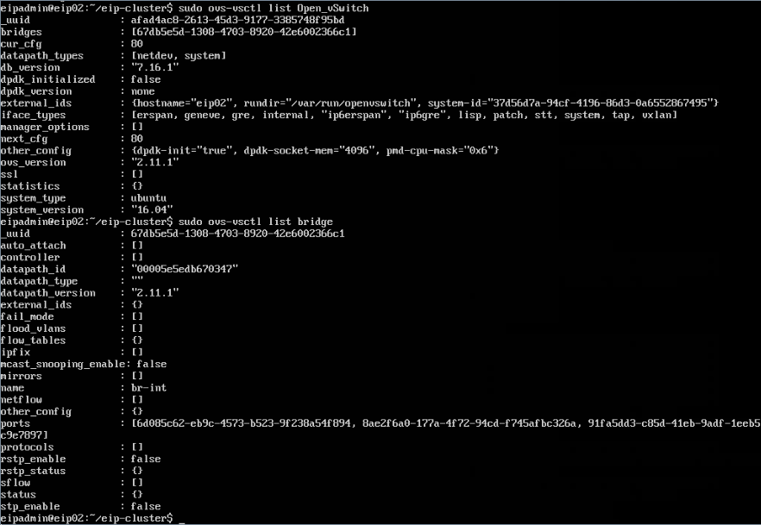
Tap in OVS
31

Slide 33
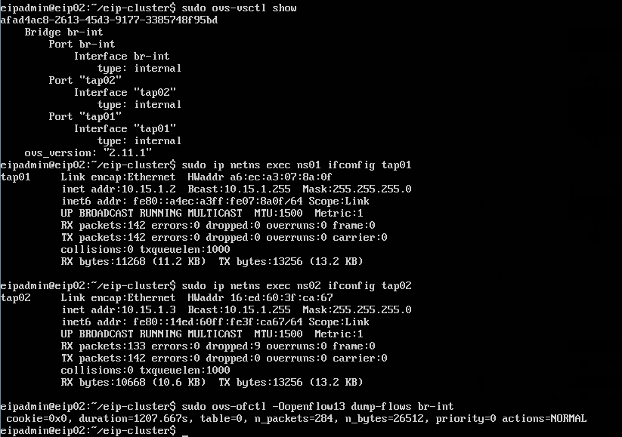
Tap in OVS
32

Slide 34
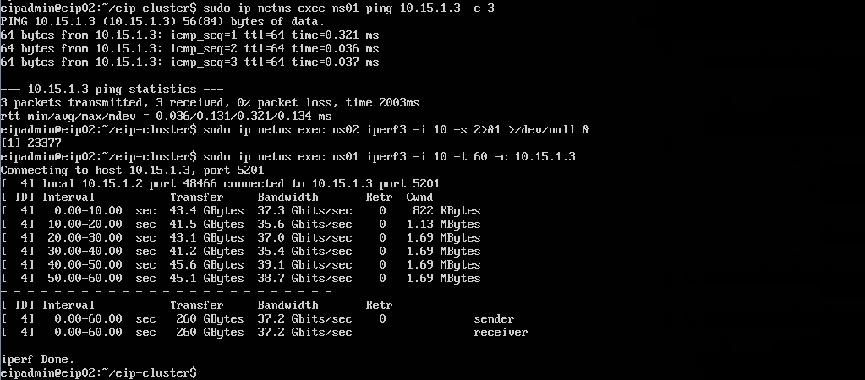
Tap in OVS
33

Slide 35
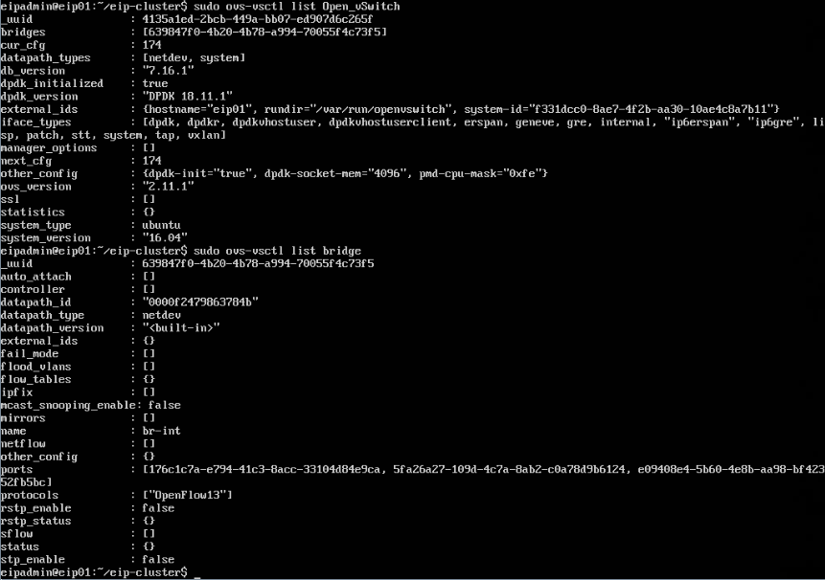
Tap in OVS DPDK
34

Slide 36
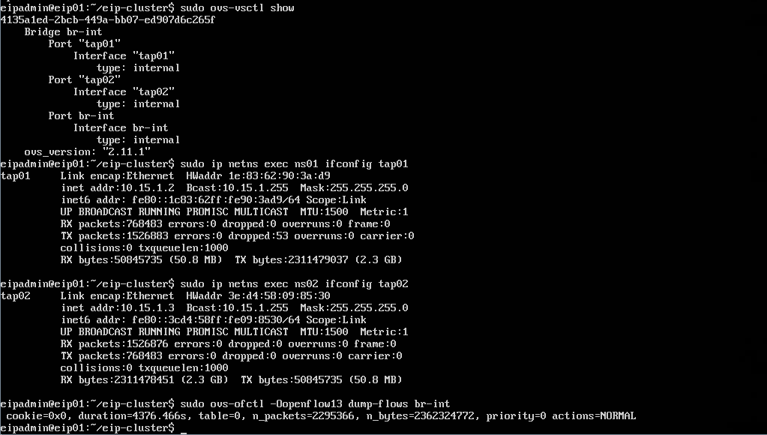
Tap in OVS DPDK
35

Slide 37
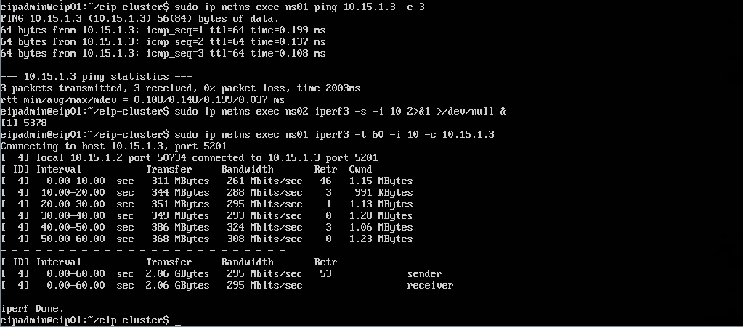
Tap in OVS DPDK
36

Slide 38
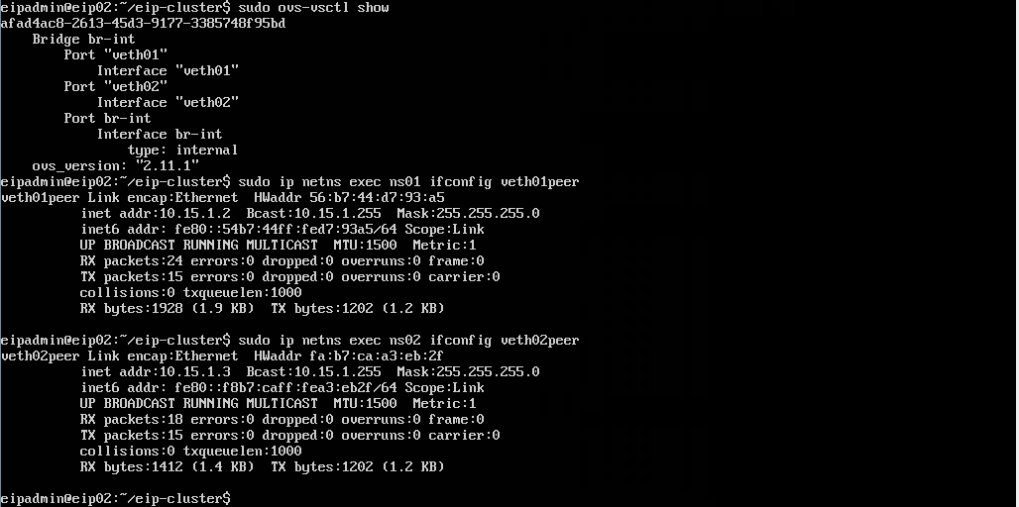
Veth in OVS
37

Slide 39

Veth in OVS
38

Slide 40
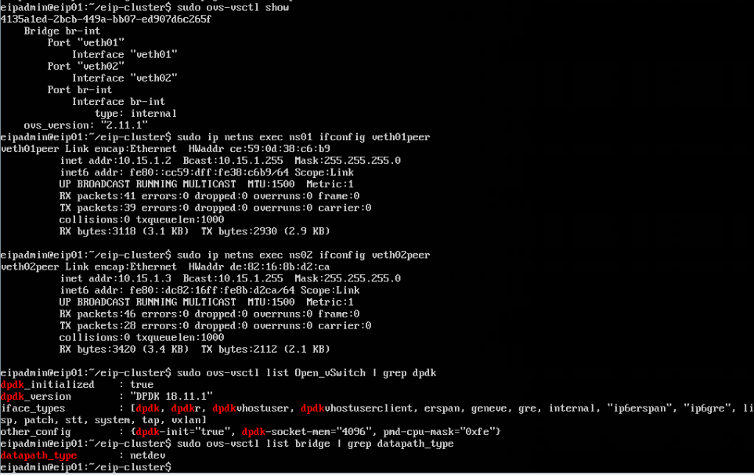
Veth in OVS DPDK
39

Slide 41
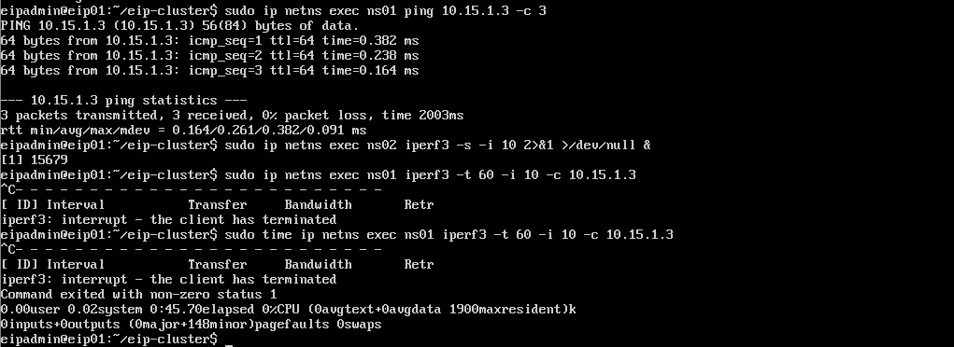
Veth in OVS DPDK
40

Slide 42
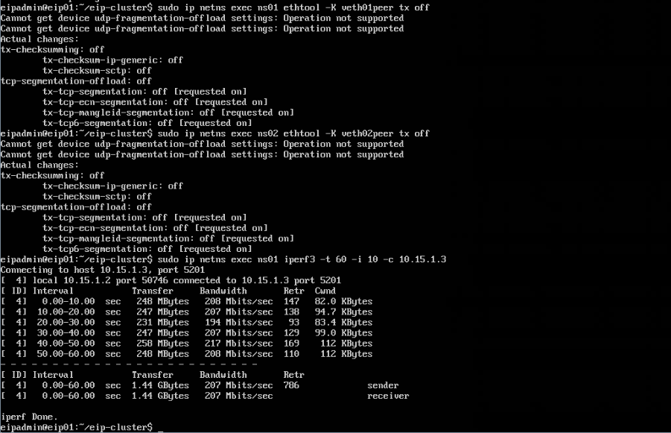
Veth in OVS DPDK
41

Slide 43
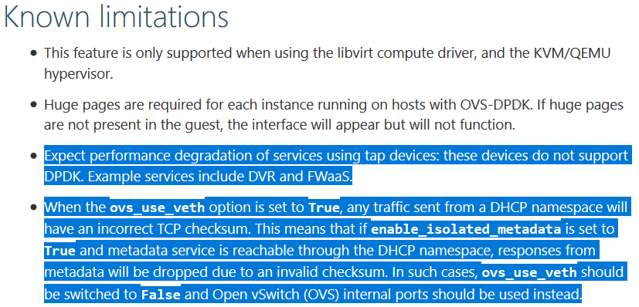
Warnings from third parties about OVS DPDK
42
https://docs.openstack.org/neutron/latest/admin/config-ovs-dpdk.html

Slide 44
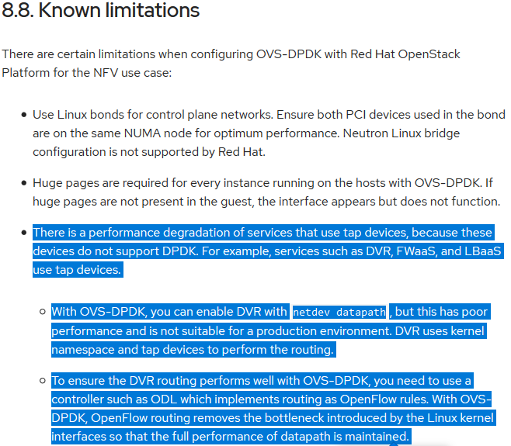
Warnings from third parties about OVS DPDK
43
https://access.redhat.com/documentation/en-us/red_hat_openstack_platform/12/html/network_functions_virtualization_planning_and_configuration_guide/part-dpdk-configure#r-ovsdpdk-limitations

Slide 45
Summary of OVS DPDK issues
44
Tap and veth performance is extremely poor in OVS DPDK.
Openstack Neutron + OVS DPDK isn’t one possible option in production environment at all.
k8s + Openstack Neutron + OVS DPDK isn’t one possible option either for baremetal use case.

Slide 46
Solutions to Issues
45
Use batch process for tap and veth recv
netdev_linux_batch_rxq_recv_sock replaces netdev_linux_rxq_recv_sock
netdev_linux_batch_rxq_recv_tap replaces netdev_linux_rxq_recv_tap
in lib/netdev-linux.c, patch was posted here (https://patchwork.ozlabs.org/patch/1204939/) by me
To use virtio_user by vdev for tap and veth interface
for tap interface:
$ sudo modprobe vhost_net
$ sudo ovs-vsctl add-port br-int virtio_user0 -- set Interface virtio_user0 type=dpdk options:dpdk-devargs=net_virtio_user0,path=/dev/vhost-net,queue_size=1024
Note: kernel >= 4.19
for veth interface:
$ sudo ovs-vsctl add-port br-int virtio_user0 -- set Interface virtio_user0 type=dpdk options:dpdk-devargs=net_virtio_user0,path=/dev/vhost-net,iface=vethbr0,queue_size=1024,mrg_rxbuf=0
But needs to change DPDK to support raw socket, also to change Linux kernel (net/packet/af_packet.c), not ready for production environment.
Note: Openstack neutron is also required to change to support them for this solution.
SDN controller (such as Opendaylight) because all the features are openflow-based, no tap and veth used, no in-kernel routing.
OVN

Slide 47
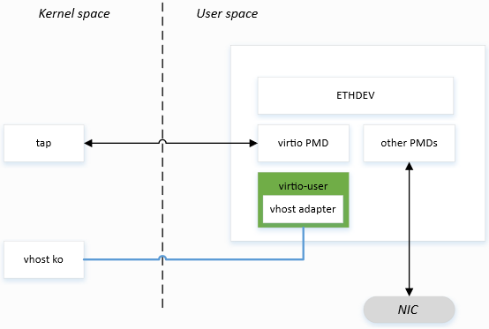
Principle of virtio_user
46

Slide 48
batch process performance for tap interface
47
eipadmin@eip01:~$ sudo ovs-vsctl show
afad4ac8-2613-45d3-9177-3385748f95bd
Bridge br-int
Port "tap0"
Interface "tap0"
type: internal
Port "tap1"
Interface "tap1"
type: internal
Port br-int
Interface br-int
type: internal
ovs_version: "2.11.1"
eipadmin@eip01:~$ sudo ip netns exec ns01 ifconfig tap0
tap0 Link encap:Ethernet HWaddr 36:06:b1:0a:08:74
inet addr:10.15.1.2 Bcast:10.15.1.255 Mask:255.255.255.0
…
eipadmin@eip01:~$ sudo ip netns exec ns02 ifconfig tap1
tap1 Link encap:Ethernet HWaddr f2:f1:34:84:76:43
inet addr:10.15.1.3 Bcast:10.15.1.255 Mask:255.255.255.0
…
eipadmin@eip01:~$

Slide 49
batch process performance for tap interface
48
eipadmin@eip01:~/openvswitch-2.11.1$ sudo ip netns exec ns02 iperf3 -s -i 10 >/dev/null 2>&1 &
[1] 11110
eipadmin@eip01:~/openvswitch-2.11.1$ sudo ip netns exec ns01 iperf3 -t 60 -i 10 -c 10.15.1.3 --get-server-output
Connecting to host 10.15.1.3, port 5201
[ 4] local 10.15.1.2 port 48490 connected to 10.15.1.3 port 5201
[ ID] Interval Transfer Bandwidth Retr Cwnd
[ 4] 0.00-10.00 sec 2.21 GBytes 1.90 Gbits/sec 66 1.20 MBytes
[ 4] 10.00-20.00 sec 2.19 GBytes 1.88 Gbits/sec 10 981 KBytes
[ 4] 20.00-30.00 sec 2.39 GBytes 2.05 Gbits/sec 6 1.28 MBytes
[ 4] 30.00-40.00 sec 2.29 GBytes 1.97 Gbits/sec 5 1.12 MBytes
[ 4] 40.00-50.00 sec 2.33 GBytes 2.00 Gbits/sec 4 986 KBytes
[ 4] 50.00-60.00 sec 2.31 GBytes 1.98 Gbits/sec 5 1.24 MBytes
- - - - - - - - - - - - - - - - - - - - - - - - -
[ ID] Interval Transfer Bandwidth Retr
[ 4] 0.00-60.00 sec 13.7 GBytes 1.96 Gbits/sec 96 sender
[ 4] 0.00-60.00 sec 13.7 GBytes 1.96 Gbits/sec receiver
Server output:
Accepted connection from 10.15.1.2, port 48488
[ 5] local 10.15.1.3 port 5201 connected to 10.15.1.2 port 48490
[ ID] Interval Transfer Bandwidth
[ 5] 0.00-10.00 sec 2.20 GBytes 1.89 Gbits/sec
[ 5] 10.00-20.00 sec 2.19 GBytes 1.88 Gbits/sec
[ 5] 20.00-30.00 sec 2.39 GBytes 2.05 Gbits/sec
[ 5] 30.00-40.00 sec 2.29 GBytes 1.97 Gbits/sec
[ 5] 40.00-50.00 sec 2.33 GBytes 2.00 Gbits/sec
[ 5] 50.00-60.00 sec 2.31 GBytes 1.98 Gbits/sec
iperf Done.
eipadmin@eip01:~/openvswitch-2.11.1$

Slide 50
batch process performance for veth interface
49
eipadmin@eip01:~$ sudo ovs-vsctl show
afad4ac8-2613-45d3-9177-3385748f95bd
Bridge br-int
Port br-int
Interface br-int
type: internal
Port "vethbr1"
Interface "vethbr1"
Port "vethbr0"
Interface "vethbr0"
ovs_version: "2.11.1"
eipadmin@eip01:~$ sudo ip netns exec ns01 ifconfig veth0
veth0 Link encap:Ethernet HWaddr 72:61:47:3a:3d:50
inet addr:10.15.1.2 Bcast:10.15.1.255 Mask:255.255.255.0
…
eipadmin@eip01:~$ sudo ip netns exec ns02 ifconfig veth1
veth1 Link encap:Ethernet HWaddr 2e:b1:bd:e8:9f:cc
inet addr:10.15.1.3 Bcast:10.15.1.255 Mask:255.255.255.0
…
eipadmin@eip01:~$

Slide 51
batch process performance for veth interface
50
eipadmin@eip01:~/openvswitch-2.11.1$ sudo ip netns exec ns02 iperf3 -s -i 10 >/dev/null 2>&1 &
[1] 11477
eipadmin@eip01:~/openvswitch-2.11.1$ sudo ip netns exec ns01 iperf3 -t 60 -i 10 -c 10.15.1.3 --get-server-output
Connecting to host 10.15.1.3, port 5201
[ 4] local 10.15.1.2 port 48494 connected to 10.15.1.3 port 5201
[ ID] Interval Transfer Bandwidth Retr Cwnd
[ 4] 0.00-10.00 sec 1.70 GBytes 1.46 Gbits/sec 14041 103 KBytes
[ 4] 10.00-20.00 sec 1.79 GBytes 1.53 Gbits/sec 14428 102 KBytes
[ 4] 20.00-30.00 sec 1.73 GBytes 1.49 Gbits/sec 13678 103 KBytes
[ 4] 30.00-40.00 sec 1.72 GBytes 1.48 Gbits/sec 14136 112 KBytes
[ 4] 40.00-50.00 sec 1.67 GBytes 1.44 Gbits/sec 14586 102 KBytes
[ 4] 50.00-60.00 sec 1.67 GBytes 1.44 Gbits/sec 13826 107 KBytes
- - - - - - - - - - - - - - - - - - - - - - - - -
[ ID] Interval Transfer Bandwidth Retr
[ 4] 0.00-60.00 sec 10.3 GBytes 1.47 Gbits/sec 84695 sender
[ 4] 0.00-60.00 sec 10.3 GBytes 1.47 Gbits/sec receiver
Server output:
Accepted connection from 10.15.1.2, port 48492
[ 5] local 10.15.1.3 port 5201 connected to 10.15.1.2 port 48494
[ ID] Interval Transfer Bandwidth
[ 5] 0.00-10.00 sec 1.69 GBytes 1.45 Gbits/sec
[ 5] 10.00-20.00 sec 1.79 GBytes 1.54 Gbits/sec
[ 5] 20.00-30.00 sec 1.73 GBytes 1.49 Gbits/sec
[ 5] 30.00-40.00 sec 1.72 GBytes 1.48 Gbits/sec
[ 5] 40.00-50.00 sec 1.67 GBytes 1.44 Gbits/sec
[ 5] 50.00-60.00 sec 1.67 GBytes 1.44 Gbits/sec
iperf Done.
eipadmin@eip01:~/openvswitch-2.11.1$

Slide 52
virtio_user performance for tap interface
51
eipadmin@eip01:~$ sudo ovs-vsctl show
4135a1ed-2bcb-449a-bb07-ed907d6c265f
Bridge br-int
Port br-int
Interface br-int
type: internal
Port "virtio_user1"
Interface "virtio_user1"
type: dpdk
options: {dpdk-devargs="net_virtio_user1,path=/dev/vhost-net,queue_size=1024"}
Port "virtio_user0"
Interface "virtio_user0"
type: dpdk
options: {dpdk-devargs="net_virtio_user0,path=/dev/vhost-net,queue_size=1024"}
ovs_version: "2.11.1“
eipadmin@eip01:~$ sudo ip netns exec ns01 ifconfig tap0
tap0 Link encap:Ethernet HWaddr 4e:72:65:35:d9:ce
inet addr:10.15.1.2 Bcast:10.15.1.255 Mask:255.255.255.0
…
eipadmin@eip01:~$ sudo ip netns exec ns02 ifconfig tap1
tap1 Link encap:Ethernet HWaddr 3a:20:8e:4f:ed:26
inet addr:10.15.1.3 Bcast:10.15.1.255 Mask:255.255.255.0
…
eipadmin@eip01:~$

Slide 53
virtio_user performance for tap interface
52
eipadmin@eip01:~$ sudo ip netns exec ns02 iperf3 -s -i 10 >/dev/null 2>&1 &
[1] 22598
eipadmin@eip01:~$ sudo ip netns exec ns01 iperf3 -t 60 -i 10 -c 10.15.1.3 --get-server-output
Connecting to host 10.15.1.3, port 5201
[ 4] local 10.15.1.2 port 49782 connected to 10.15.1.3 port 5201
[ ID] Interval Transfer Bandwidth Retr Cwnd
[ 4] 0.00-10.00 sec 6.26 GBytes 5.38 Gbits/sec 74 1.26 MBytes
[ 4] 10.00-20.00 sec 6.29 GBytes 5.41 Gbits/sec 69 1.60 MBytes
[ 4] 20.00-30.00 sec 6.29 GBytes 5.40 Gbits/sec 91 1.46 MBytes
[ 4] 30.00-40.00 sec 6.28 GBytes 5.40 Gbits/sec 89 1.23 MBytes
[ 4] 40.00-50.00 sec 6.28 GBytes 5.40 Gbits/sec 30 1.54 MBytes
[ 4] 50.00-60.00 sec 6.27 GBytes 5.38 Gbits/sec 157 1.33 MBytes
- - - - - - - - - - - - - - - - - - - - - - - - -
[ ID] Interval Transfer Bandwidth Retr
[ 4] 0.00-60.00 sec 37.7 GBytes 5.39 Gbits/sec 510 sender
[ 4] 0.00-60.00 sec 37.7 GBytes 5.39 Gbits/sec receiver
Server output:
Accepted connection from 10.15.1.2, port 49780
[ 5] local 10.15.1.3 port 5201 connected to 10.15.1.2 port 49782
[ ID] Interval Transfer Bandwidth
[ 5] 0.00-10.00 sec 6.23 GBytes 5.35 Gbits/sec
[ 5] 10.00-20.00 sec 6.29 GBytes 5.41 Gbits/sec
[ 5] 20.00-30.00 sec 6.29 GBytes 5.40 Gbits/sec
[ 5] 30.00-40.00 sec 6.28 GBytes 5.40 Gbits/sec
[ 5] 40.00-50.00 sec 6.28 GBytes 5.40 Gbits/sec
[ 5] 50.00-60.00 sec 6.27 GBytes 5.38 Gbits/sec

Slide 54
virtio_user performance for veth interface
53
eipadmin@eip01:~$ sudo ovs-vsctl show
4135a1ed-2bcb-449a-bb07-ed907d6c265f
Bridge br-int
Port br-int
Interface br-int
type: internal
Port "virtio_user0"
Interface "virtio_user0"
type: dpdk
options: {dpdk-devargs="net_virtio_user0,path=/dev/vhost-net,iface=vethbr0,queue_size=1024,mrg_rxbuf=0"}
Port "virtio_user1"
Interface "virtio_user1"
type: dpdk
options: {dpdk-devargs="net_virtio_user1,path=/dev/vhost-net,iface=vethbr1,queue_size=1024,mrg_rxbuf=0"}
ovs_version: "2.11.1"
eipadmin@eip01:~$ sudo ip netns exec ns01 ifconfig veth0
veth0 Link encap:Ethernet HWaddr 66:8c:e2:bd:dc:b4
inet addr:10.15.1.2 Bcast:10.15.1.255 Mask:255.255.255.0
inet6 addr: fe80::648c:e2ff:febd:dcb4/64 Scope:Link
UP BROADCAST RUNNING MULTICAST MTU:1500 Metric:1
…
eipadmin@eip01:~$ sudo ip netns exec ns02 ifconfig veth1
veth1 Link encap:Ethernet HWaddr f6:63:6b:e5:79:fc
inet addr:10.15.1.3 Bcast:10.15.1.255 Mask:255.255.255.0
inet6 addr: fe80::f463:6bff:fee5:79fc/64 Scope:Link
UP BROADCAST RUNNING MULTICAST MTU:1500 Metric:1
…
eipadmin@eip01:~$

Slide 55
virtio_user performance for veth interface
54
eipadmin@eip01:~$ sudo ip netns exec ns02 iperf3 -s -i 10 >/dev/null 2>&1 &
[1] 32521
eipadmin@eip01:~$ sudo ip netns exec ns01 iperf3 -t 60 -i 10 -c 10.15.1.3 --get-server-output
Connecting to host 10.15.1.3, port 5201
[ 4] local 10.15.1.2 port 44862 connected to 10.15.1.3 port 5201
[ ID] Interval Transfer Bandwidth Retr Cwnd
[ 4] 0.00-10.00 sec 2.92 GBytes 2.51 Gbits/sec 50285 112 KBytes
[ 4] 10.00-20.00 sec 2.85 GBytes 2.45 Gbits/sec 49913 90.5 KBytes
[ 4] 20.00-30.00 sec 2.85 GBytes 2.45 Gbits/sec 48886 151 KBytes
[ 4] 30.00-40.00 sec 2.86 GBytes 2.45 Gbits/sec 52214 99.0 KBytes
[ 4] 40.00-50.00 sec 2.91 GBytes 2.50 Gbits/sec 51136 153 KBytes
[ 4] 50.00-60.00 sec 3.01 GBytes 2.59 Gbits/sec 39867 90.5 KBytes
- - - - - - - - - - - - - - - - - - - - - - - - -
[ ID] Interval Transfer Bandwidth Retr
[ 4] 0.00-60.00 sec 17.4 GBytes 2.49 Gbits/sec 292301 sender
[ 4] 0.00-60.00 sec 17.4 GBytes 2.49 Gbits/sec receiver
Server output:
Accepted connection from 10.15.1.2, port 44860
[ 5] local 10.15.1.3 port 5201 connected to 10.15.1.2 port 44862
[ ID] Interval Transfer Bandwidth
[ 5] 0.00-10.00 sec 2.91 GBytes 2.50 Gbits/sec
[ 5] 10.00-20.00 sec 2.85 GBytes 2.45 Gbits/sec
[ 5] 20.00-30.00 sec 2.85 GBytes 2.45 Gbits/sec
[ 5] 30.00-40.00 sec 2.86 GBytes 2.45 Gbits/sec
[ 5] 40.00-50.00 sec 2.90 GBytes 2.50 Gbits/sec
[ 5] 50.00-60.00 sec 3.01 GBytes 2.59 Gbits/sec

Slide 56
Performance Comparison of Solutions
55
 | base(Gbps) | batch process(Gbps) | virtio_user(Gbps) | ovs kernel(Gbps)
tap | 0.295 | 1.96(x7) | 5.39(x18) | 37.2(x126)
veth | 0.207 | 1.47(x7) | 2.49(x12) | 36.3(x175)

